Slide 1
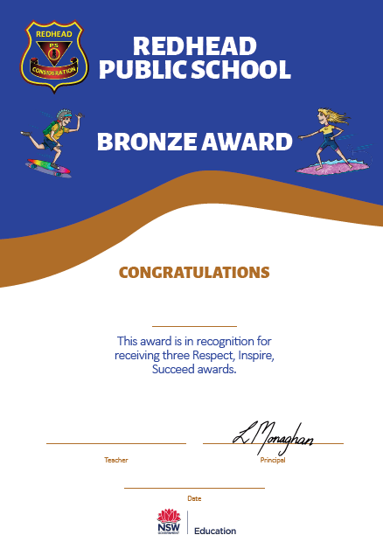
Student Awards
Redhead Public School
 | Respect, Inspire, Succeed Awards
 | A teacher sees a student following our school high expectations.
 | Awards given at fortnightly assemblies.
After receiving 3 Respect, Inspire, Succeed Awards
 | Bronze Award
 | Presented at our Termly Respect, Inspire, Succeed Assembly
After receiving 7 Respect, Inspire, Succeed Awards
 | Silver Award
 | Presented at our Termly Respect, Inspire, Succeed Assembly
After receiving 12 Respect, Inspire, Succeed Awards
 | Gold Award
 | Presented at our Termly Respect, Inspire, Succeed Assembly

Slide 2
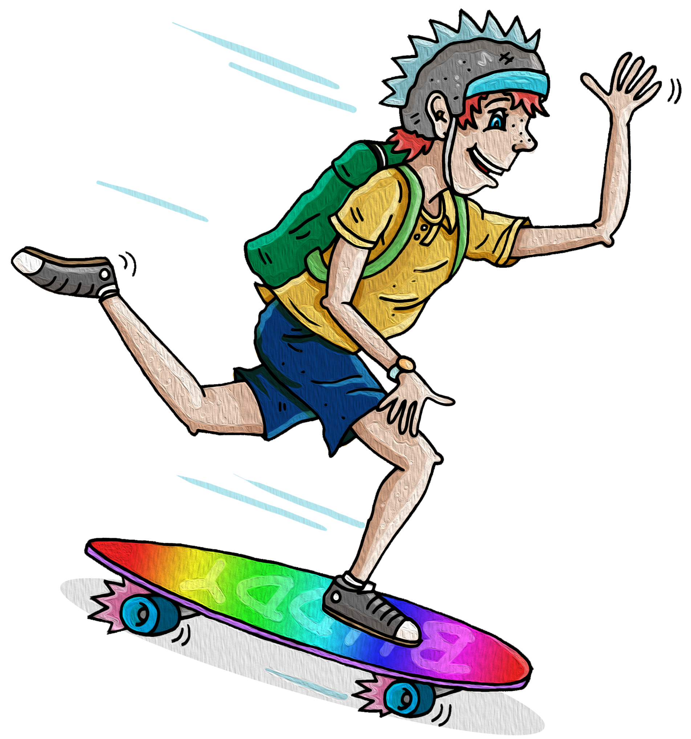
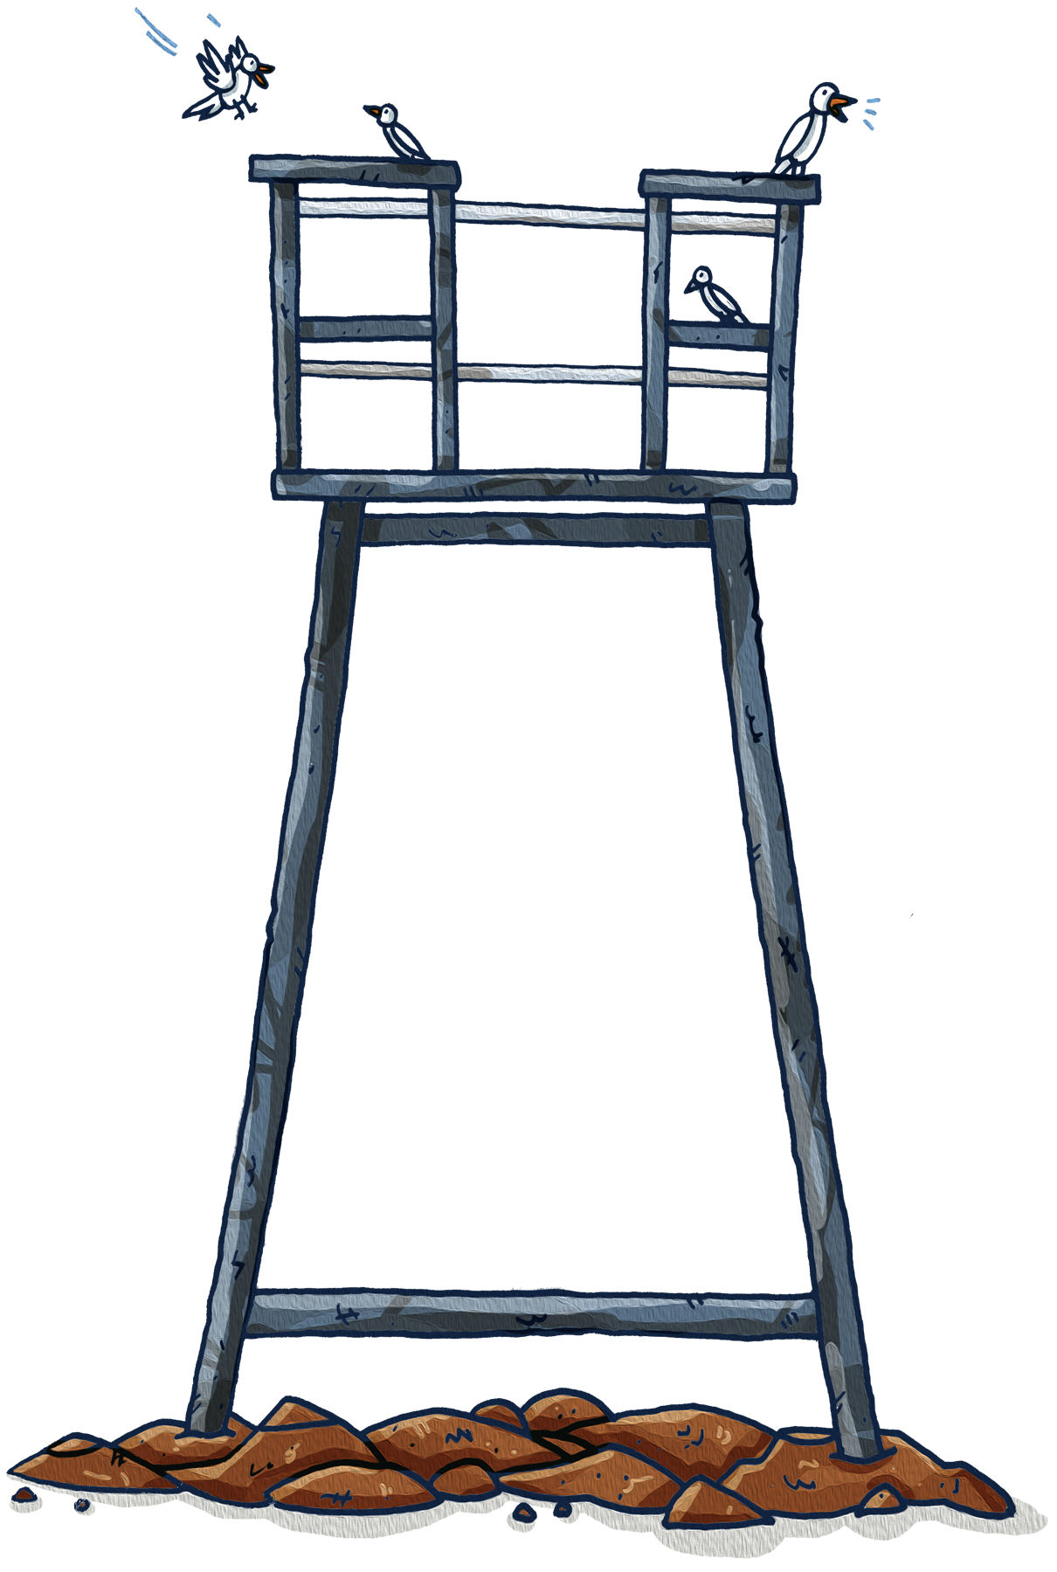
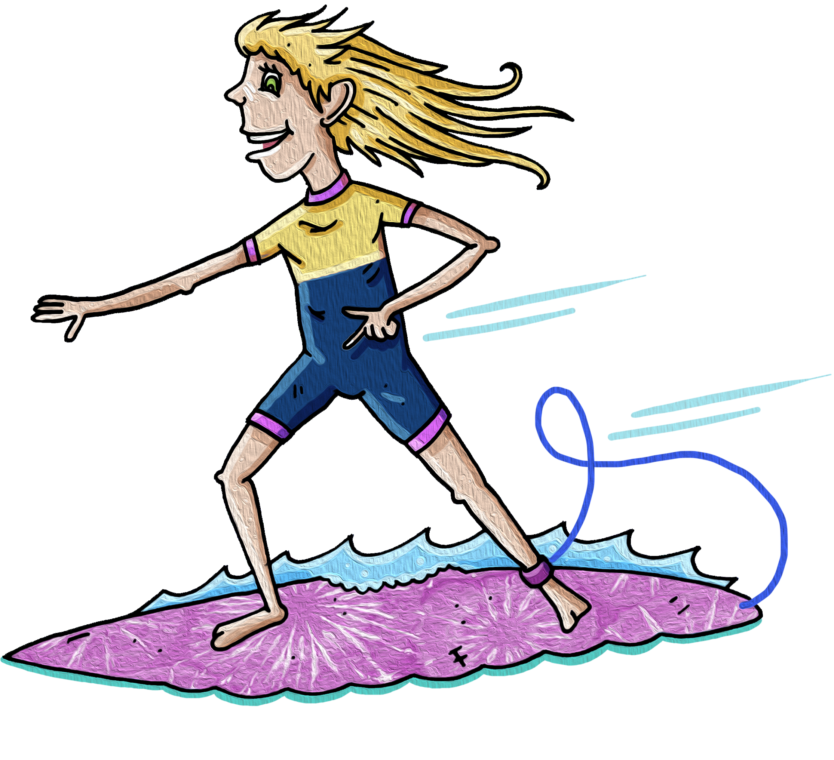
High Expectations
Redhead Public School
Behaviour Code for Students
Respect
School property
Each other
Staff
School expectations
Inspire
Growth mindset
Think creatively
Love of learning
Encourage others
Succeed
Set goals
Engage in my learning
Problem solve
Challenge myself

Slide 3
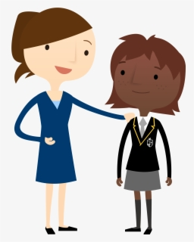
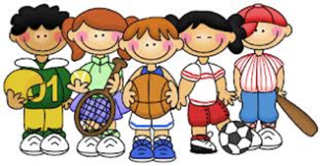
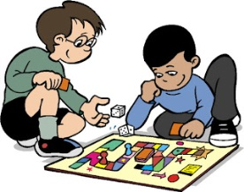
Student Wellbeing Programs
Redhead Public School
Silent Mentor
Ensure every child is known, valued and cared for within our school. At times we identify students who require a silent mentor to support with transition, social or emotional wellbeing, cultural connections, or behaviour strategies.
Coding Club
SEA
(Social, emotional awareness Program)
Focus on intervention work with our students who need support socially and emotionally. This program is based on our tier 2 Sentral data in Positive Behaviour for Learning. Regular 5 weekly data analysis of Sentral for negative incidents occurs throughout the year and identifies students, who will participate in a structured program for 5 weeks.
Library / Gaming Zone
L.E.A.P.S. Learning to Engage And Participate Socially (Lunchtime Play Program)
Gardening Club
Develop social skill behaviours that will help students develop friendships and get along with others.
Learn to relate to other children through interactions within games.
Problem-solve within games and social situations.
Learn extra social skills and problem-solving strategies that complements our school Wellbeing programs.
Chess Club

